Slide 1

Platform as a Service and Microsoft Azure Stack Hub
Azure Stack Hub PaaS Concepts and Capabilities
This work is licensed under a Creative Commons Attribution - ShareAlike 4.0 International Public License

Slide 2
Agenda
Ecosystem of Services
Delivered as a Template
Delivered as a PaaS
PaaS Overview
Introduction
Overview
PaaS in Public Azure and Azure Stack Hub
PaaS in Public Azure
PaaS in Azure Stack Hub
App Service
Web Apps, API Apps, and Functions
Service Fabric
Service Fabric

Slide 3
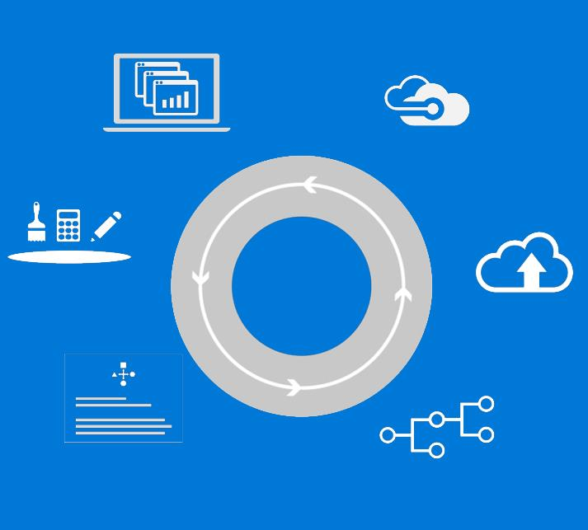
Unified application development and DevOps
Describe
Deploy
Control
Visual Studio | OSS tools
Experiences
Operations
Build and deploy apps the same way whether they run on-premises(traditional on-premises or hybrid cloud via Azure Stack Hub) or in the public cloud
Implement common DevOps practices across hybrid cloud environments.
Azure Resource Manager
Azure Resource Manager
Tools
Deployments
Consistency
Application Patterns
Automations
Azure Stack Hub
Azure

Slide 4
Azure and Azure Stack Hub Truly consistent hybrid cloud platform
Portal | PowerShell | DevOps tools
Developers
Portal | PowerShell | DevOps tools
Azure Resource Manager
Azure Resource Manager
CONSISTENCY
Azure IaaS | Azure PaaS
Azure IaaS | Azure PaaS
Compute | Networking | Storage |
App Service | Functions |
Service Fabric* | Container Service*
Cloud infrastructure
Cloud infrastructure
(Integrated systems)
IT
Azure
Azure Stack Hub
* - Post GA

Slide 5
PaaS – Platform as a Service

Slide 6



Cloud computing
IaaS
PaaS
SaaS
Infrastructure as a Service
Platform as a Service
Software as a Service
Host
Build
Consume
Notes:
[EDITOR] TWB_Trevor:
04 October 2013 What does “PDC08” refer to? Is it a reference to the Professional Developers Conference held in 2008?

Slide 7


Cloud computing contd.
Packaged Software
Infrastructure
(as a Service)
Platform
(as a Service)
Software
(as a Service)
You manage
Applications
Applications
Applications
Applications
Data
You manage
Data
Data
Data
Runtime
Runtime
Runtime
Runtime
Managed by vendor
You manage
Middleware
Middleware
Middleware
Managed by vendor
Middleware
O/S
O/S
O/S
O/S
Virtualization
Virtualization
Managed by vendor
Virtualization
Virtualization
Servers
Servers
Servers
Servers
Storage
Storage
Storage
Storage
Networking
Networking
Networking
Networking
Notes:
[EDITOR] Biju
04 October 2013 Kindly provide substantiation for the claim made against third-party software.

Slide 8





Azure Stack Hub architecture
Additional
Platform
Services
From Microsoft
Storage Blobs
Websites
(.NET, PHP, Python … )
Guest Workload Resources
(IaaS + PaaS)
Websites
(.NET, PHP, Python … )
Virtual Machines
(Linux or Windows)
Service Fabric Clusters
Virtual Networks
Service Fabric Clusters
End User Experiences
End User Experiences
Azure Portal | Developer Tools (MSFT & Open Source)
Unified App Model
Unified Application Model
Azure Resource Manager
Core Services
Core Services
Subscriptions | RBAC | Gallery | Metrics | Usage
Azure Stack Hub Software
Extensible Service Framework
Additional Platform Services
Foundational Services
Compute | Storage | Networking | Platform Services
Foundational Services
Cloud Infrastructure
Infrastructure Management
Compute
Storage
Networking
From 3rd parties
Physical Hardware

Slide 9
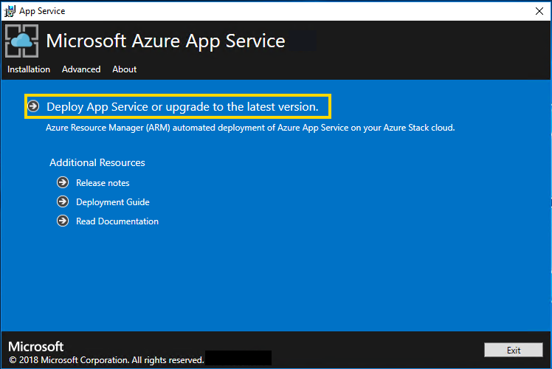
PaaS Resource Providers (RP)
None by Default
Add only as needed
~60GB+ free needed for each install
Win Server 2016 image required for all
Separate installation procedures / requirements
Can add more capacity to each later
Once installed, add to offers/plans
App Services RP
Many Prerequisites must be done first
SQL & MySQL RPs
Dependency on minimum Build version
Can Provide access to external MySQL/SQL Servers

Slide 10
PaaS using templates in Azure Stack Hub
As an Azure Stack Hub Operator, you are given PaaS as part of Azure Stack Hub using Resource Providers, but you can also offer PaaS by deploying and managing IaaS templates to deliver PaaS solutions to your users…
Packaged Software
Infrastructure
(as a Service)
PaaS (Using Resource Provider)
Software
(as a Service)
You manage
Applications
Applications
Applications
Applications
Data
You manage
Data
Data
Data
Runtime
Runtime
Runtime
Runtime
Managed by vendor
You manage
Middleware
Middleware
Middleware
Managed by vendor
Middleware
O/S
O/S
O/S
O/S
Virtualization
Virtualization
Managed by vendor
Virtualization
Virtualization
Servers
Servers
Servers
Servers
Storage
Storage
Storage
Storage
Networking
Networking
Networking
Networking
PaaS (Using IaaS templated app)
Applications
You manage
Data
Runtime
Templated app
Middleware
O/S
Virtualization
Managed by vendor
Servers
Storage
Networking
Notes:
[EDITOR] Biju
04 October 2013 Kindly provide substantiation for the claim made against third-party software.

Slide 11
PaaS RP vs templates
With a Resource Provider:
The underlying resources are abstracted from the user and maintenance functions of those resources can be done by an administrator in the portal or using scripting/API calls:
Deployment
Updates
Monitoring
Certificate rotation
BCDR
Resource Providers are multi-tenant
Template-based deployments:
Must be managed like IaaS
Would have distinct management tools and procedures
Would be deployed to serve a specific user
Are less efficient in using resources when operating in a multi-tenant environment
PaaS (Using Resource Provider)
PaaS (Using IaaS templated app)
You manage
Applications
Applications
Data
You manage
Data
Runtime
Runtime
Templated app
Middleware
Managed by vendor
Middleware
O/S
O/S
Virtualization
Virtualization
Managed by vendor
Servers
Servers
Storage
Storage
Networking
Networking
Notes:
[EDITOR] Biju
04 October 2013 Kindly provide substantiation for the claim made against third-party software.

Slide 12

New Resource Providers
Upcoming enhancements to the Azure Stack Hub Marketplace will allow you to obtain, install, maintain, and remove Resource Providers.
This allows you to obtain new PaaS capabilities from the Marketplace
Not available yet!
PaaS (Using Resource Provider)
PaaS (Using IaaS templated app)
You manage
Applications
Applications
Data
You manage
Data
Runtime
Runtime
Templated app
Middleware
Managed by vendor
Middleware
O/S
O/S
Virtualization
Virtualization
Managed by vendor
Servers
Servers
Storage
Storage
Networking
Networking
Notes:
[EDITOR] Biju
04 October 2013 Kindly provide substantiation for the claim made against third-party software.

Slide 13

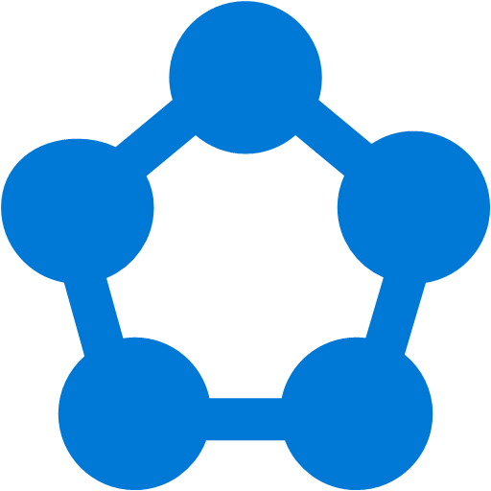
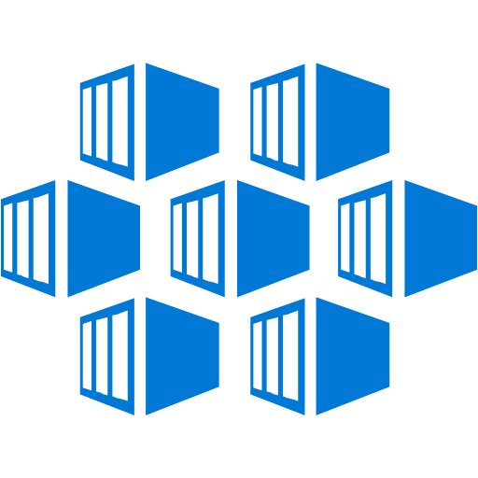
Azure PaaS available on-premises – Fully managed platforms for high productivity development
Azure App Service
Azure Functions
Azure Service Fabric
Azure Container Service
Cloud Foundry
Templated Version
Templated Version
Templated Version
Web, and API apps
Serverless computing
Always-on, scalable distributed applications
Robust container management
Open source platform

Slide 14
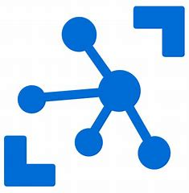
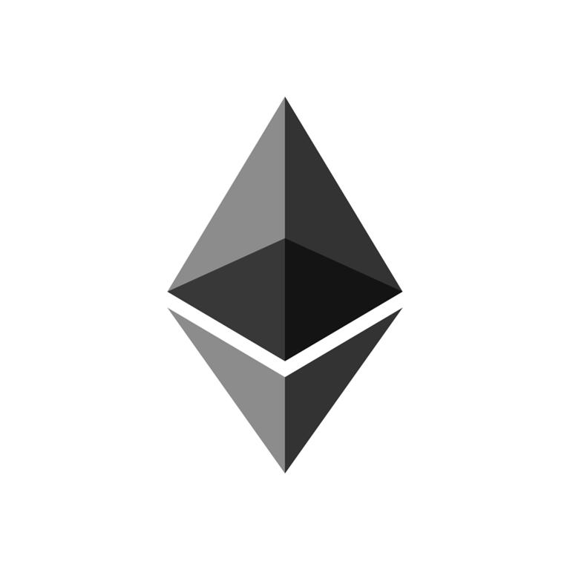
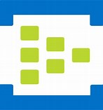
Azure PaaS available on-premises – managed platforms for high productivity development
Azure IoT
Azure Ethereum Blockchain
Azure Event Hub
Templated Version
Templated Version
Templated Version
Build IoT applications with extreme low latency at the edge
Block chain services based on Ethereum
Build high throughput event streaming applications

Slide 15
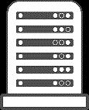
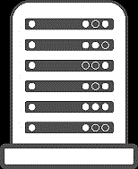

One Azure ecosystem
Mac OS X and Windows
Windows Server and Linux
Visual Studio
Eclipse
Azure Portal
GitHub
…
PowerShell
Docker
Chef and Puppet
…
Tools
Experiences
Automations
Azure Ecosystem
Microsoft Azure
Microsoft Azure Stack Hub

Slide 16
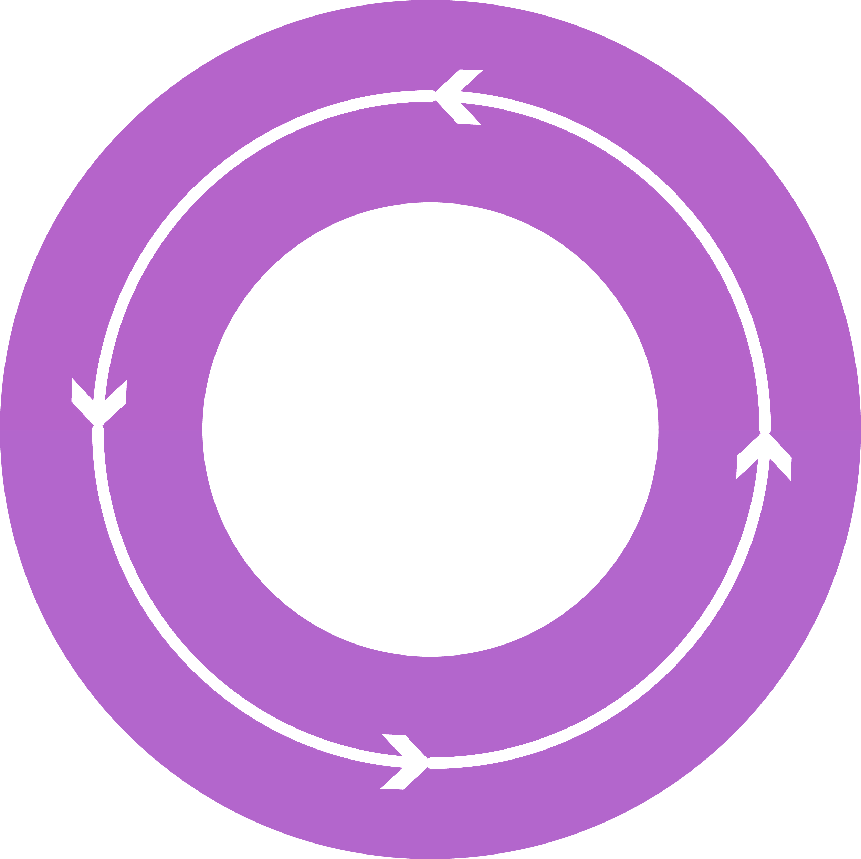
Additional Platform Services from Microsoft Azure
Develop Azure Services
Deliver services using
your datacenter
Repeat
Operate at
hyper-scale
Add provider experiences
Scale and integration points

Slide 17
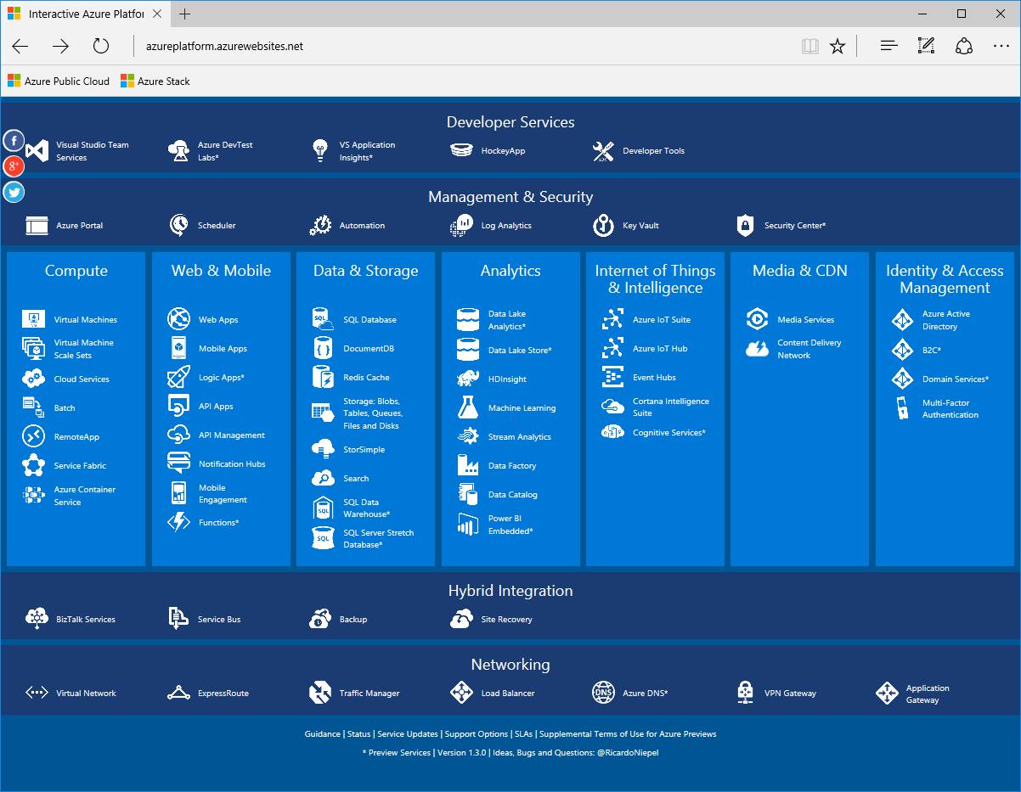
Platform Services from Microsoft Azure
http://azureplatform.azurewebsites.net/

Slide 18




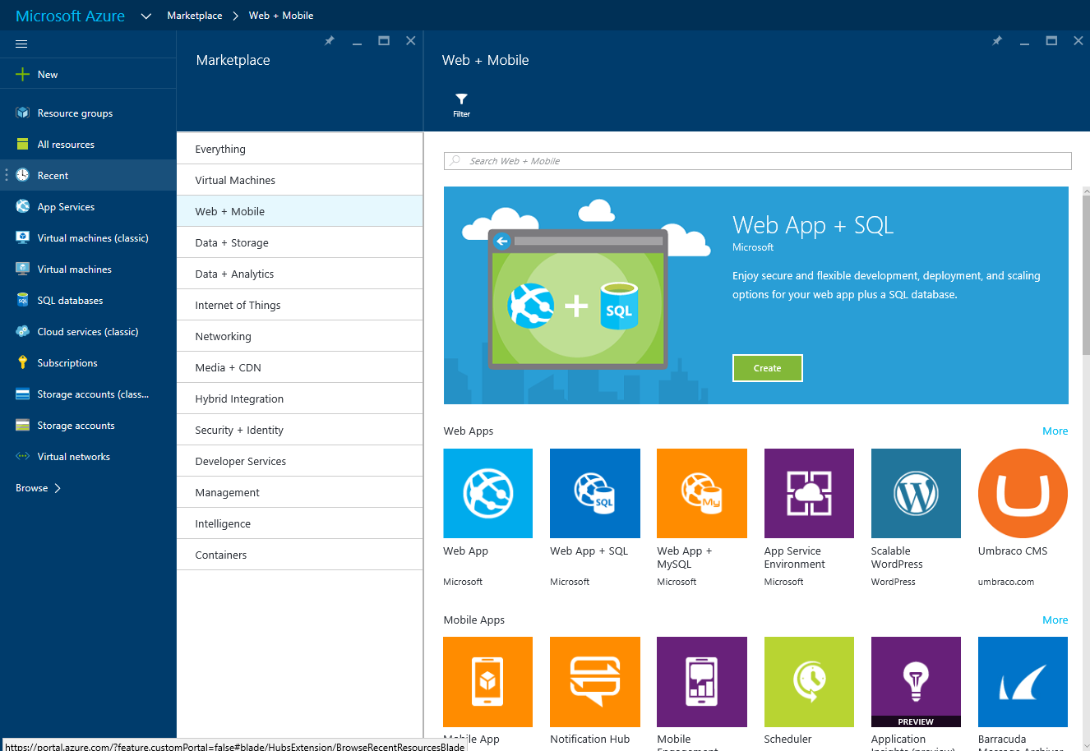



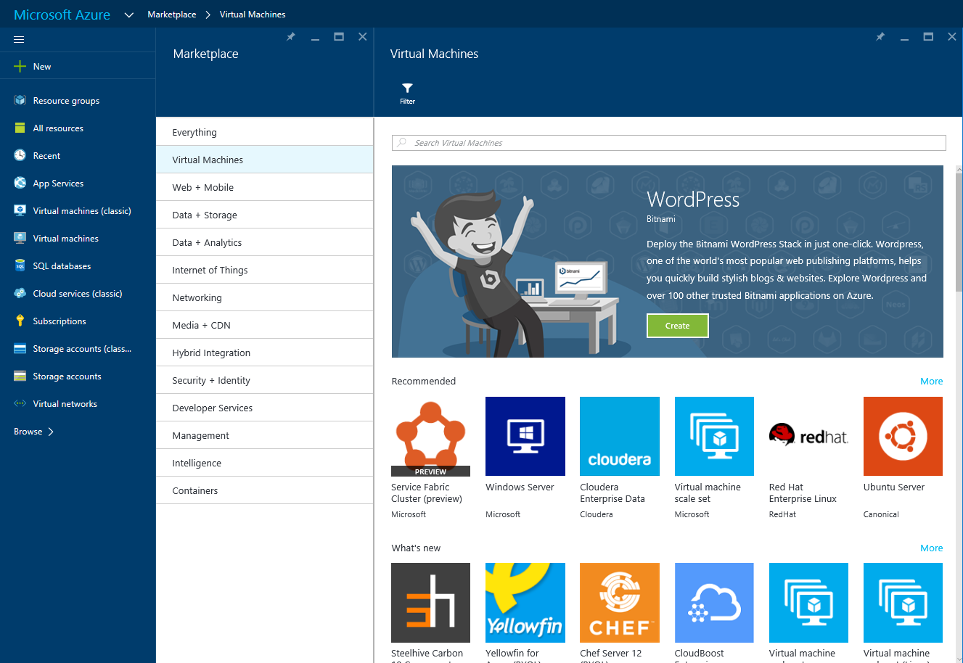




















































Developer Services
Visual Studio
DevTest Labs
VS Application Insights
HockeyApp
Developer Tools
Visual Studio
DevTest Labs
VS Application Insights
HockeyApp
Developer Tools
Add Developer Services that work with Azure Stack Hub
Management & Security
Azure Portal
Automation
Key Vault
Azure Portal
Scheduler
Automation
Log Analytics
Key Vault
Log Analytics
Security Center
Compute
Web & Mobile
Data & Storage
Analytics
IoT & Intelligence
Media & CDN
Identity & Access Management
Web Apps
Data Lake Analytics
Virtual Machines
Web Apps
SQL Database
Virtual Machines
Media Services
Azure IoT Suite
Azure Active Directory
DocumentDB
Azure Active Directory
Mobile Apps
Mobile Apps
Azure Stack Hub starts lighting UP!
Virtual Machines
Scale Sets
Data Lake Store
Virtual Machines
Scale Sets
Foundational Services basis for IaaS Virtual Machines
Add Web & Mobile Platform Services
“Preview at GA”
Azure IoT Hub
Content Delivery Network
Logic Apps
Redis Cache
HDInsight
B2C
Blobs, Tables, Queues, Files, Disks
Cloud Services
API Apps
Blobs, Tables, Queues, Files, Disks
Event Hubs
API Apps
Machine Learning
Domain Services
API Management
Cortana Intelligence Suite
Batch
API Management
Multi-Factor Authentication
StorSimple
Multi-Factor Authentication
Stream Analytics
Add Container Services & Service Fabric for PaaS v2
“Preview at GA”
With Additional Azure Services that Interoperate with Azure Stack Hub
Notification Hubs
Remote App
Notification Hubs
Search
Data Factory
Cognitive Services
Mobile Engagements
Mobile Engagements
SQL Data Warehouse
Data Catalog
Service Fabric
Service Fabric
Functions
Container Service
Functions
Container Service
SQL Server Stretch Database
Power BI Embedded
Hybrid Integration
BizTalk Services
Service Bus
Backup
Site Recover
Backup
Site Recover
Networking
Virtual Network
Express Route
Traffic Manager
Load Balancer
Azure DNS
VPN Gateway
Application Gateway
Virtual Network
Express Route
Traffic Manager
Load Balancer
Azure DNS
VPN Gateway

Slide 19
PaaS in Azure Stack Hub

Slide 20
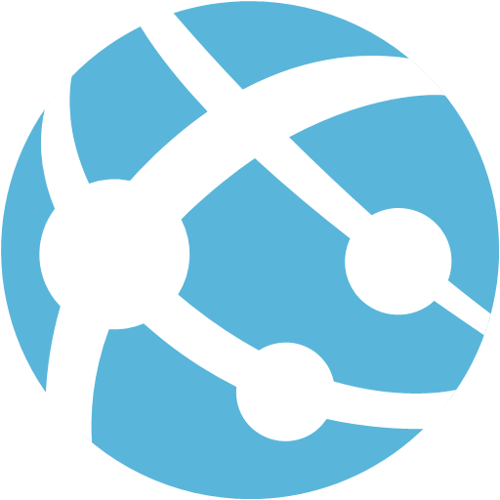
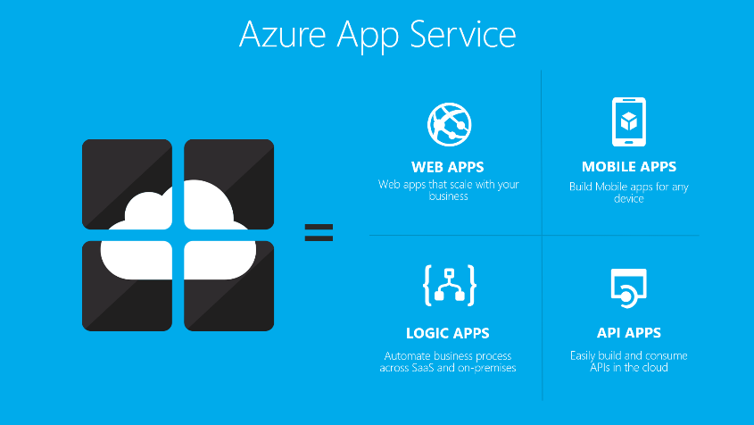
App Service | Web Apps
Allows developers rapidly build, deploy, and manage powerful websites and web apps using standards-based solutions and APIs
Web apps allow customers to:
Create personalized customer experiences
Scale up and out quickly
Centralize web sites on one platform
Enable continuous deployment with Git, TFS, GitHub, and Visual Studio Team Services
Build solutions based on Windows and Linux images
Coming Later
Coming Later
Service category | App Service
API version | Various to 2016-08-01 (parity with Azure)
https://azure.microsoft.com/en-us/services/app-service/web

Slide 21

App Service | API Apps
Support the building, hosting, and consumption of APIs in the cloud and on-premises. API apps provide enterprise grade security, simple access control, hybrid connectivity, and automatic SDK generation. Key features include: Bring your existing API as-is – Code changes in existing APIs is not required to take advantage of API Apps Easy consumption – Integrated support for Swagger API metadata makes your APIs easily consumable by a variety of clients. Simple access control – Protects an API app from unauthenticated access with no changes to your code and provides built-in authentication services Visual Studio integration – Dedicated tools in Visual Studio streamline the work of creating, deploying, consuming, debugging, and managing API apps.
Service category | App Service
API version | Various to 2016-08-01 (parity with Azure)
https://azure.microsoft.com/en-us/services/app-service/api

Slide 22

App Service | Functions
Azure Functions is a solution for easily running small pieces of code, or "functions," in the cloud.
Solution for processing data, integrating systems, working with the internet-of-things (IoT), and building simple APIs and microservices.
Key features of Azure Functions:
Choice of language – Write functions using C#, F#, Node.js, Python, PHP, batch, bash, or any executable.
Bring your own dependencies – Supports NuGet, and NPM
Integrated security – Protect HTTP-triggered functions with OAuth providers such as Azure Active Directory, Facebook, Google, Twitter, and Microsoft Account
Simplified integration – Easily leverage Azure services and software-as-a-service (SaaS) offerings
Flexible development – Supports continuous integration and deploy your code through GitHub, VSTS, and other supported development tools
Open-source – The Functions’ runtime is open-source and available on GitHub
Service category | App Service
API version | Various to 2016-08-01 (parity with Azure)
https://azure.microsoft.com/en-us/services/functions

Slide 23
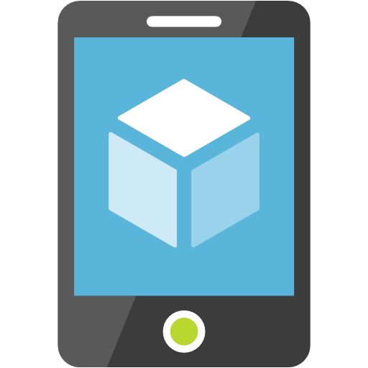
App Service | Mobile Apps | Logic Apps
Not Available In Azure Stack Hub…
https://azure.microsoft.com/en-us/services/app-service/mobile

Slide 24
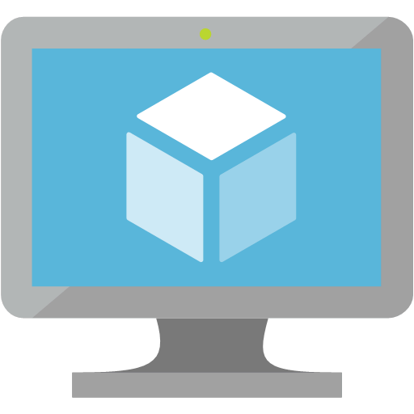
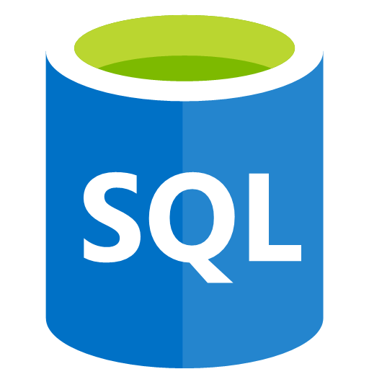
SQL Server
This feature, based on the codebase from Azure Pack, is ported to Azure Stack Hub.
The SQL Server Resource Provider can be used to manage SQL server resources (IaaS). You use this resource provider to connect to a SQL Server instance running in a VM.
The Resource Provider allows for management of SQL Server databases, and hosting servers.
SQL Server Resource Provider supported operations:
Create, delete, update, and retrieve databases
Create, validate, delete, update, and retrieve hosting servers
Retrieve resource provider metrics
Considerations
An administrator needs to manage the underlying IaaS Instance of SQL (patching, capacity planning, performance monitoring, etc.)
Any external SQL Server can be used, including SQL standalone servers, and VMs on Azure Stack Hub or Azure, as long as network connectivity can be achieved
No parity with SQL DB on Azure
Support for AlwaysOn Availability Groups
Service category | Data and Storage
API version | N/A
https://technet.microsoft.com/en-us/library/dn469341.aspx

Slide 25
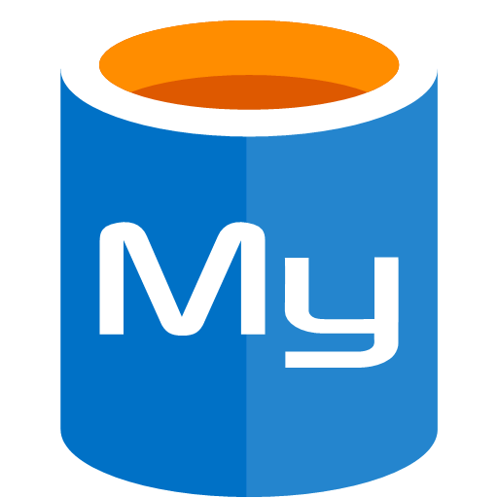
MySQL Server
This feature is based on the codebase from Azure Pack is ported to Azure Stack Hub.
The SQL Server Resource Provider can be used to manage MySQL resources (IaaS). This MySQL instance is also running in a VM – not as a PaaS service.
The Resource Provider allows for management of MySQL databases, and hosting servers.
MySQL Resource Provider supported operations:
Create, delete, update, and retrieve MySQL databases.
Create, validate, delete, update, and retrieve hosting servers.
Retrieve database metrics.
Considerations
An admin needs to manage the underlying IaaS Instance (same as SQL Server)
No parity with new Azure MySQL
Multiple MySQL versions are supported including Community Editions, clustered versions, and licensed software
Service category | Data and Storage
API version | N/A
https://technet.microsoft.com/en-us/library/dn469341.aspx

Slide 26
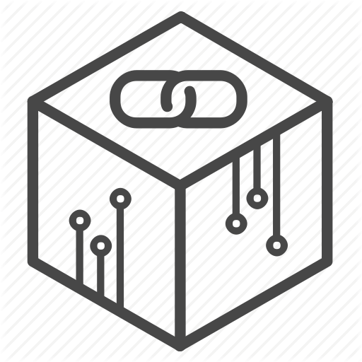
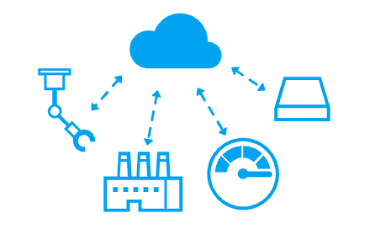
IoT Services on Azure Stack Hub
Coming Soon!
IoT services are under development for Azure Stack Hub
Will include IoT Hub and Event Hub
Private preview by end of 2018
See Azure IoT Hub and Azure Event Hub
Service category | Compute
API version | NA
Availability | Not available yet
AzureStack considerations:
Not yet available. Will appear as a private preview by end of 2018, followed by a public preview

Slide 27
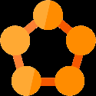
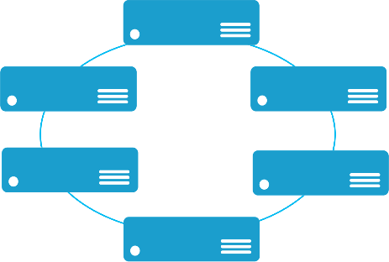
Service Fabric
Templated Version
Enables building and managing scalable and reliable applications composed of microservices that run at very high density on a shared pool of machines (cluster).
Provides a sophisticated runtime to build distributed, scalable, stateless and stateful microservices.
Provides comprehensive application management capabilities to provision, deploy, monitor, upgrade/patch, and delete deployed applications.
A microservice application separates functionality into separate smaller services.
Scales out by deploying each service independently creating instances of these services across servers /VMs/containers.
Service category | Compute
API version | Final Version
Availability | Marketplace template available now
AzureStack considerations:
This version of Service Fabric uses a clustered set of VMs built out from a Marketplace template that uses IaaS with PowerShell DSC for configuring the cluster. It is not a Resource Provider like App Service or SQL/mySQL
https://azure.microsoft.com/en-us/services/service-fabric

Slide 28
Kubernetes service
Templated Version
Develop massively scalable, upgradable, applications that can be deployed in seconds
Simplify the design of your application and improve its reliability by different Helm applications. Helm is an open-source packaging tool that helps you install and manage the lifecycle of Kubernetes applications
Easily monitor and diagnose the health of your applications with scale and upgrade functionality
Other Kubernetes tools, like the Kuberbetes-as-a-Service Rancher can also run on Azure Stack Hub
The actual application running on top of an AKS cluster is agnostic to whether it is running in public Azure or Azure Stack Hub – meaning high application portability between the clouds
.
Service category | Compute
API version | NA
Availability | Marketplace template available now
AzureStack considerations:
You can install Kubernetes using Azure Resource Manager templates generated by the ACS-Engine on Azure Stack Hub
The generated template is not the same managed AKS service offered in global Azure.
The generated ARM template deploys and provisions resources for Kubernetes in a single, coordinated operation
https://docs.microsoft.com/en-us/azure/aks/
https://docs.microsoft.com/en-us/azure/azure-stack/user/azure-stack-solution-template-kubernetes-deploy

Slide 29
Blockchain Etherium service
Templated Version
Deploy a blockchain solution with Etherium
single-click deployment through the Azure Stack Hub tenant portal
Each member can provision their network footprint, consisting of a set of load-balanced transaction nodes with which an application or user can interact to submit transactions, a set of mining nodes to record transactions, and a Network Virtual Appliance (NVA)
A subsequent connection step connects the NVAs to create a fully configured multi-member blockchain network
Service category | Compute
API version | NA
Availability | Marketplace template available now
AzureStack considerations:
You can install Blockchain Etherium using Azure Resource Manager templates available in the marketplace
The templated deployment is not the same as the Azure Blockchain service
https://docs.microsoft.com/en-us/azure/azure-stack/user/azure-stack-ethereum

Slide 30
Development, deployment, and management consistency across clouds
Consistent set of ARM Templates accommodating API version supports
Template validators for Azure Stack Hub
Consistent tool experience for PaaS Services
Visual Studio
Portal
CLI
Kudu (for web apps)

Slide 31
What if a desired Azure service is not available in Azure Stack Hub?
Deploy a hybrid solution, combining Azure Stack Hub services with Azure services
Where this is not possible, there are some services that can be run in IaaS on Azure Stack Hub as substitute for Azure services
For example Apache Cassandra/DataStax to run a NoSQL database instead of Azure CosmosDB

Slide 32
Developer Consistency
Visual Studio – Cloud Explorer – Consistent experience
Connect to Public Cloud
Connect to MAS
VS – Deploy – Same flow when deploying either to Public or MAS
Deploy to Azure
Deploy to MAS
Source Control Providers – Similar options
Local Git
GitHub
BitBucket
OneDrive
DropBox

Slide 33
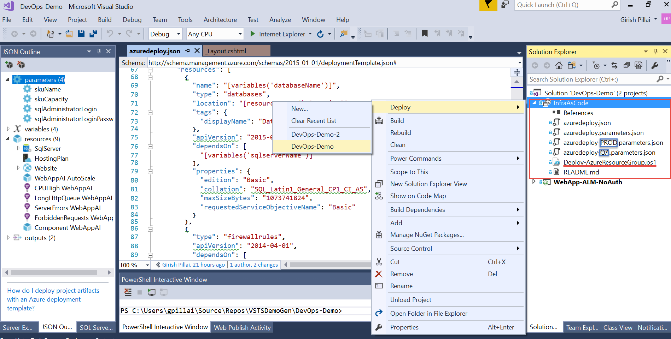

Slide 34
Questions?

